Slide 1

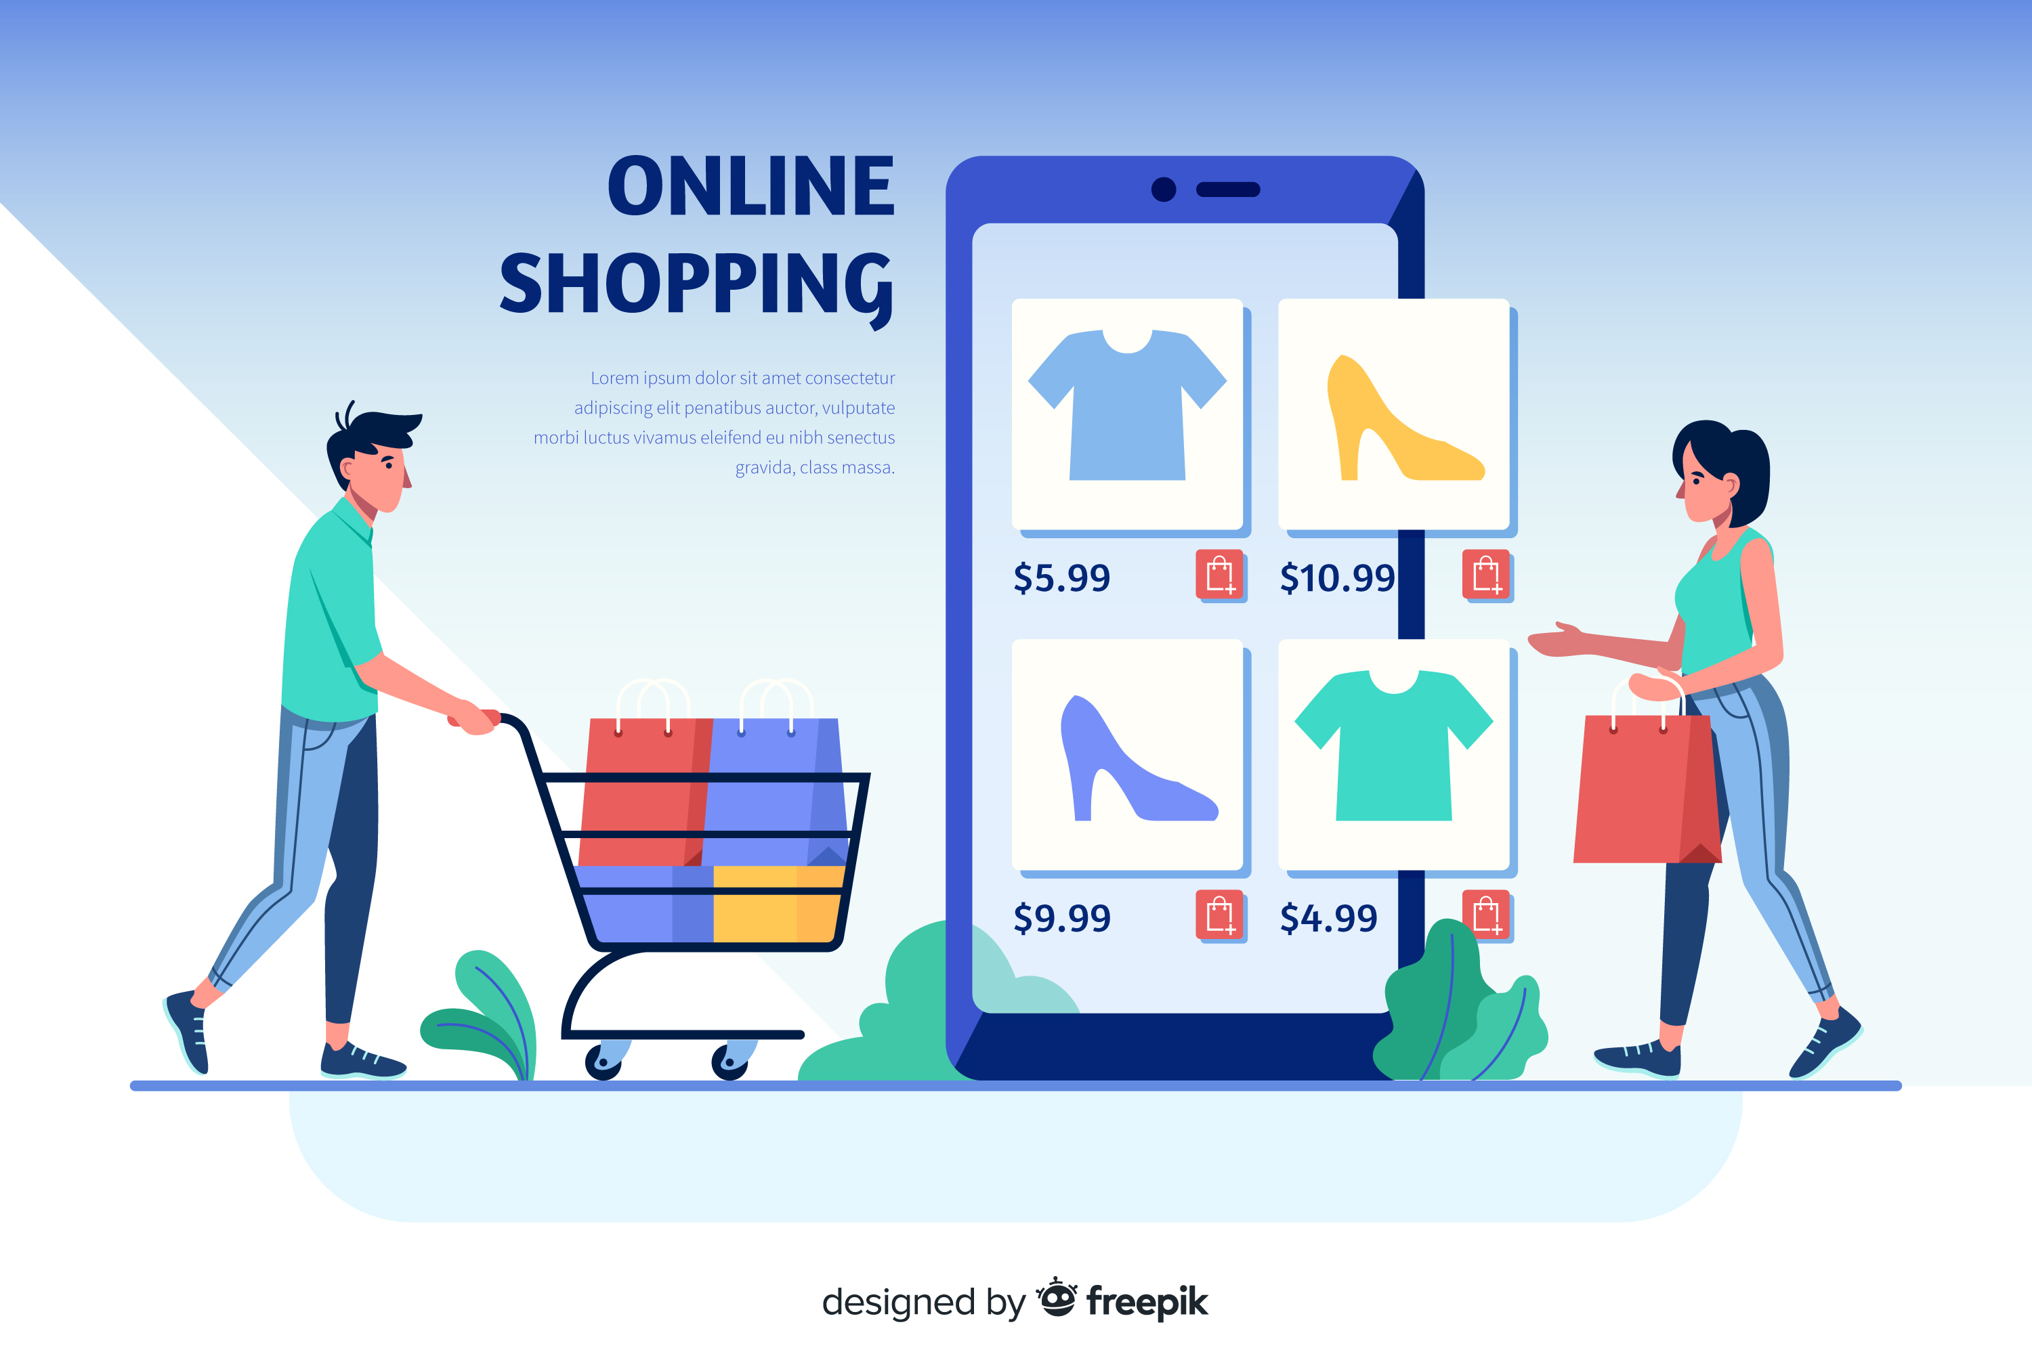
Online Shopping
Online Shopping Data Analysis
Presentation by Harshit Bhargava

Slide 2

Online Shopping
Table of Content
Introduction
Fundamental Insights
Sales and Order Trends
Strategic Insights
Customer Centric Insights
Recommendation

Slide 3
Online Shopping
Introduction
This Analysis takes place to understand or navigate the future of Online Shopping.
Report Overview
In Online Shopping,
Highlight the challenges faced in Online shopping .
Identifying is it beneficial or not?
Purpose of the Report

Slide 4
Online Shopping
Fundamental Insights
Total Unique Cities 4119
Orders in 2017 45101
Total Revenue
16.01M
Max Sales Category
Health and Beauty
Installment Order percentage

Slide 5
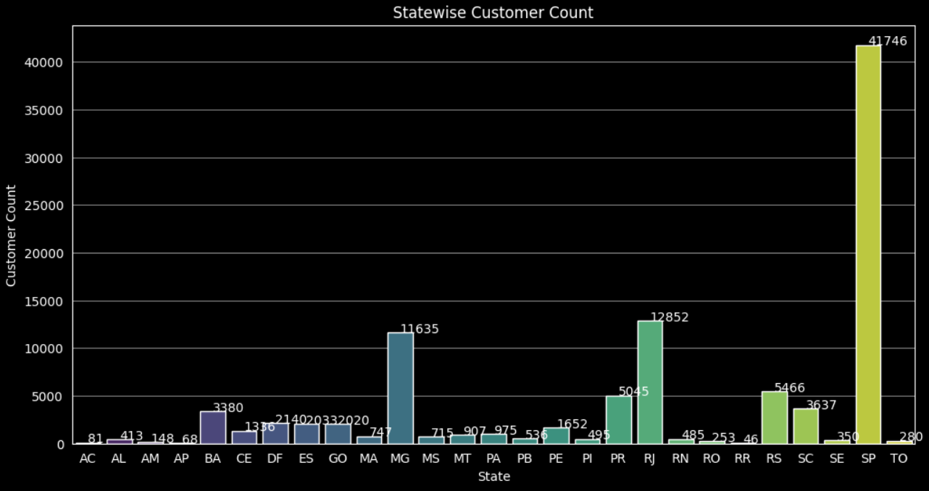
Online Shopping
Fundamental Insights
State-wise Customer Count ensures which state has max customer.
.

Slide 6
Online Shopping
Sales and Order Trend
.
Month-wise Orders Qty helps to analyze the customers and sales trend.

Slide 7
Online Shopping
Sales and Order Trend
This helps in understanding the market demand i.e. which category has more or less demand

Slide 8
Online Shopping
Sales and Order Trend
Ecommerce

Slide 9
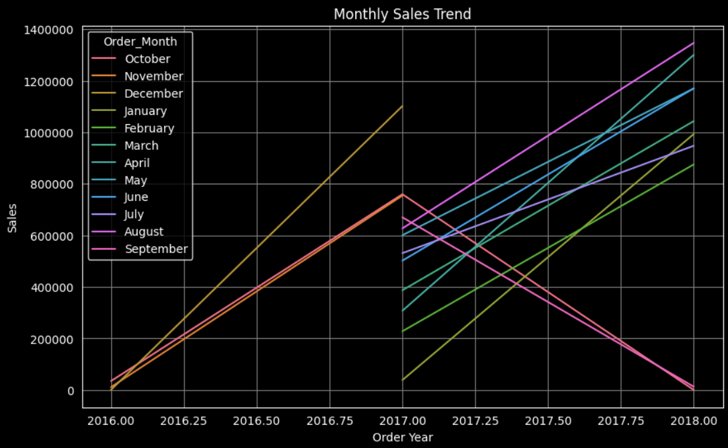
Online Shopping
Strategic Insights

Slide 10
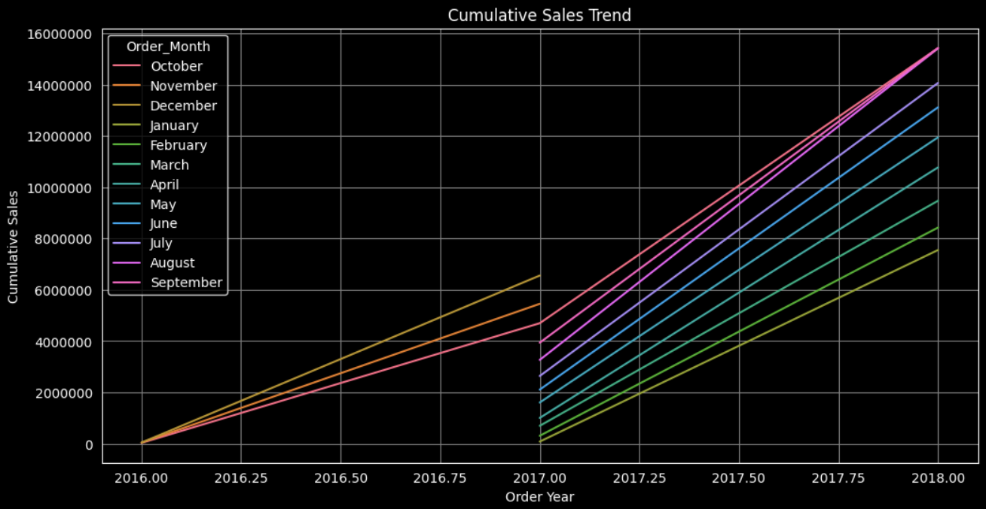
Online Shopping
Strategic Insights
Cumulative Sales Trend helps in tracking overall business performance, identifying sales trends, and making data-driven decisions

Slide 11
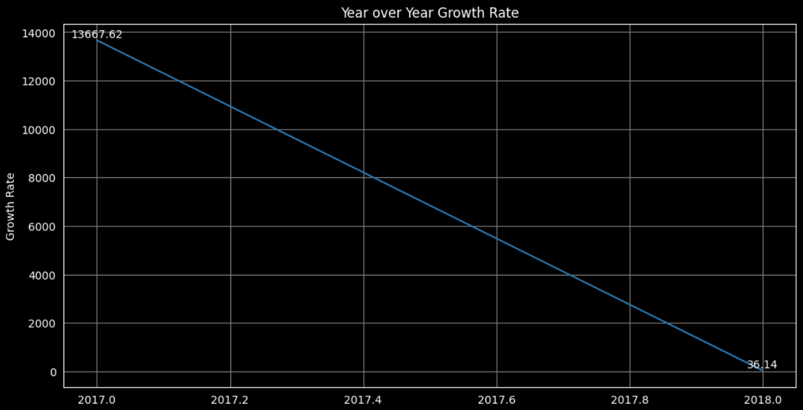
Online Shopping
Strategic Insights
Year over Year growth helps understand whether a company or economic entity is growing, shrinking, or remaining stable.

Slide 12
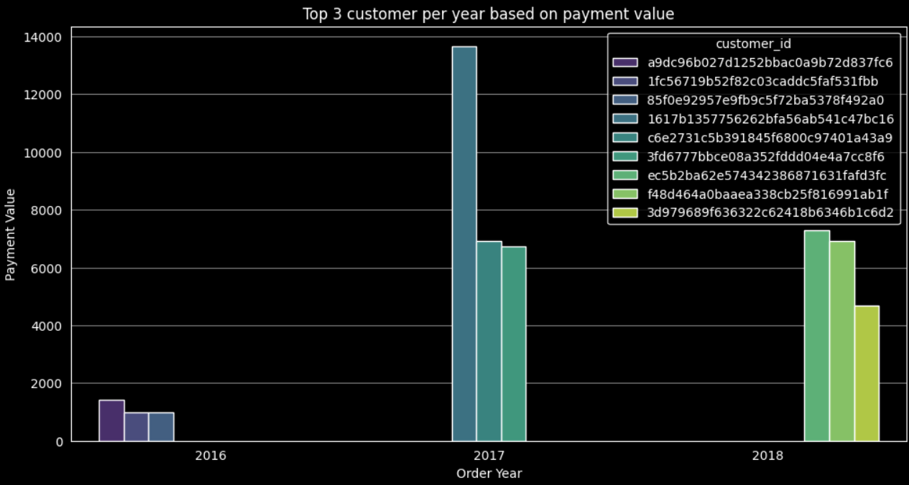
Online Shopping
Customer Centric Insights
Year over Year growth helps understand whether a company or economic entity is growing, shrinking, or remaining stable.

Slide 13

E-Commerce Company
Challenges and Opportunities
Challenges
Opportunities
Data Security
High Competition
Logistics and Delivery
Price War
Global Reach
Lower Overhead
Targeted Marketing
Niche Markets

Slide 14

E-Commerce Company
Recommendation
To increase the revenue:-
You need to focus on less performing area and improve services in top performing locations.
Urge a proper advertisement of the company and manage proper resources in those area.
Have a proper stock of product and most ordered sizes.
For Customer Satisfaction:-
As we find you have more Expedited shipping type so you need to improve your delivery time and provide better customer support.
To cut the Competitive edge in retail landscape:-
Provide good Quality product at lower price you may have small margin on a product but it will increase your overall revenue by increasing the number of orders

Slide 15
E-Commerce Company
Thank You
for your attention

